Slide 1
Introduction of work in ASML
RLKM
YieldStar SW

Slide 2
Agenda
YieldStar Metrology
TM Task(ACPD)
Source project overview
V-model

Slide 3
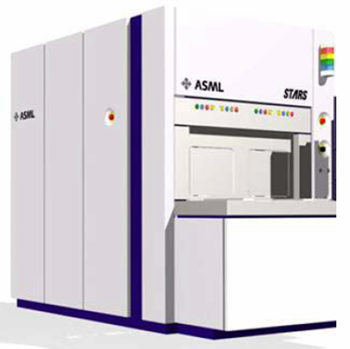
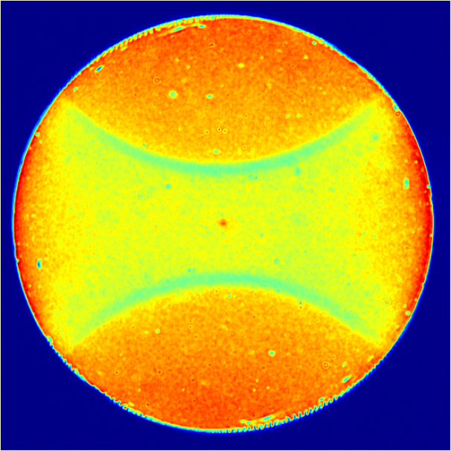
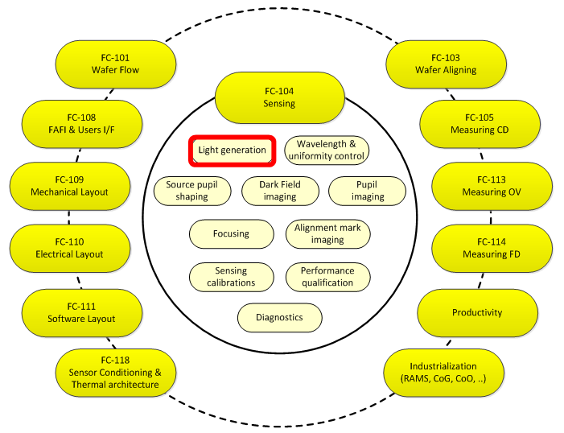
YieldStar Introduction
YieldStar hardware
Raw measurement signal
Relevant metrics
“OV”
“CD”
CD = “Critical dimensions”
OV = “Overlay”

Slide 4
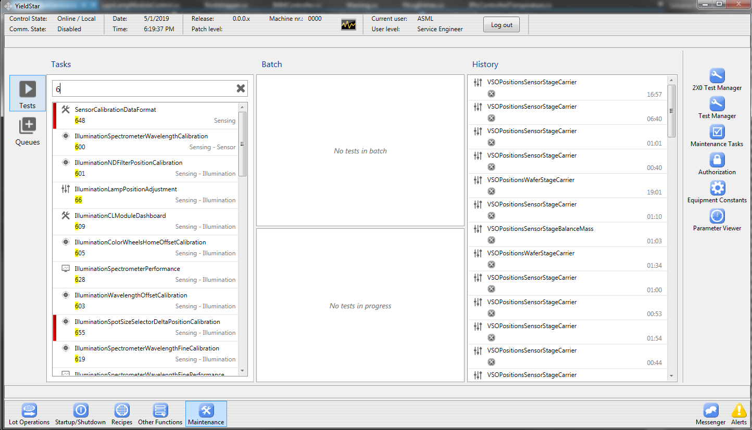
Task Manager User Interface

Slide 5
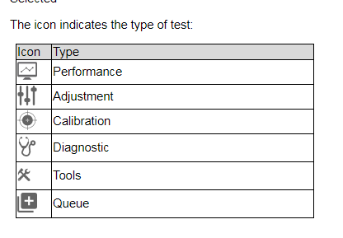
Task types
Adjustment
Adjust the system. User Interface, operator feedback
Calibration
Calibrate the system. Update equipment constants
Performance
Measure the performance of the system
The different task types share functionality (Measure, Recognize…)

Slide 6
Technologies
Windows Presentation Foundation (WPF)
“Next-generation presentation system for building Windows client applications”
Caliburn Micro MVVM framework
Bootstrapping UI, Conventions to link view to ViewModels
Windows Communication Foundation (WCF)
Communication between client and service processes based on contracts
AutoFac
Inversion of Control, Dependency Injection
XSLT
Output report template
Rhino and Moq framework
Unit-Test framework

Slide 7
Model View ViewModel
Client
TaskView
UI Element
Display images
Translate keystrokes/mouse clicks into commands for the ViewModel
WPF DataBinding
TaskViewModel
Connects Model to View
Convert Model data to a format the View can bind to
Forward commands from the View to the Model
WCF
Server
Acquire and publish images
Perform calculations and publish results
TaskModel
Does not know about UI

Slide 8
#Task 402 Class Diagram

Slide 9



Source Component Overview
LPPS
Spectrometer
Mixing fiber
Y
H
Z
Cal. source
V
F1
F2
F3
F4
OPTICAL BASE FRAME
L1
L6
L5
≅ 4%
L4
M2
BS2
L2
L3
ND1
5x ND
1x slot
3x spare
M1
≅4%
M3
BS1
LWP
SWP
ND2
MOTOR FRAME

Slide 10
CLM tasks overview
Internal Spectrometer
CL Module
Task 623
DC Offset
Task 604
DC offset
Task 600
WL coarse
Task 605
WL home offset
Task 611
Non-linearity
Task 612
Irradiance
Task 602
Enc Pos to WL
Task 625
Enc Pos to WL
Task 626
WL fine
Task 619
WL fine
Task 601
ND filter
Task 641
ND filter
Task 628
Spectrometer
Task 603
WL offset
Task 630 has 603 included
Task 630
CLM spectral
existing calibration
< SP18
new calibration
performance task

Slide 11
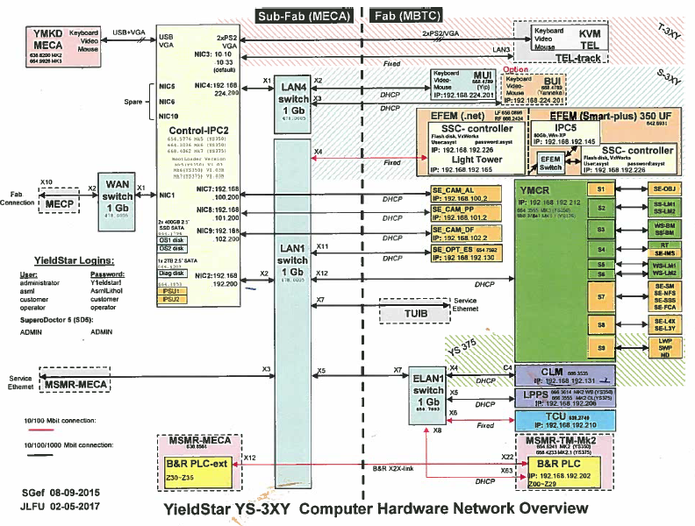
YS component network connection

Slide 12
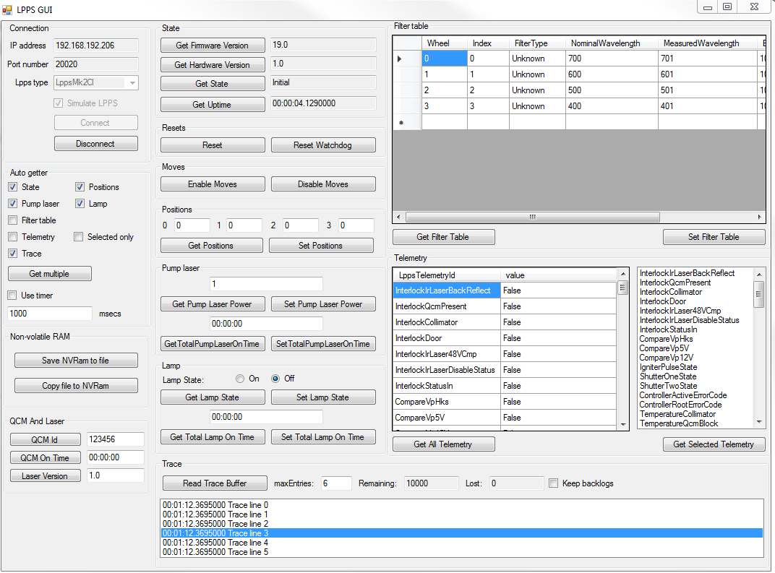
LPPS GUI
WinForm
AutoFac
The QCM and Laser block : related to QCM and Laser hardware

Slide 13
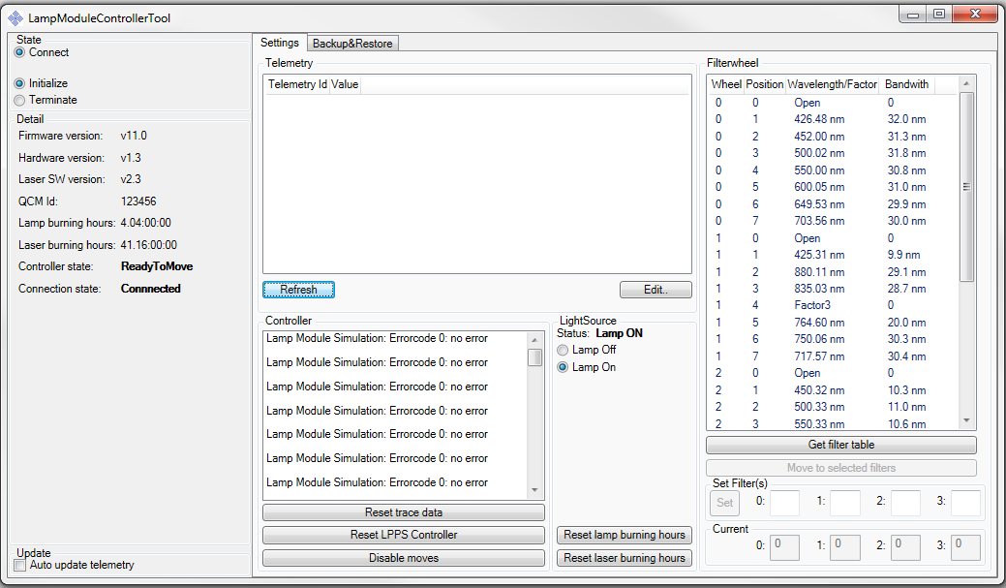
LampModuleControllerTool
WCF
WPF

Slide 14
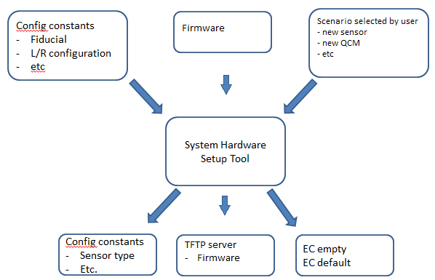
Introduction to System Hardware Setup Tool
The hardware setup tool prepares the system for recovery after a spare part swap or hardware upgrade.
It achieves this by setting the correct configuration and equipment constants

Slide 15
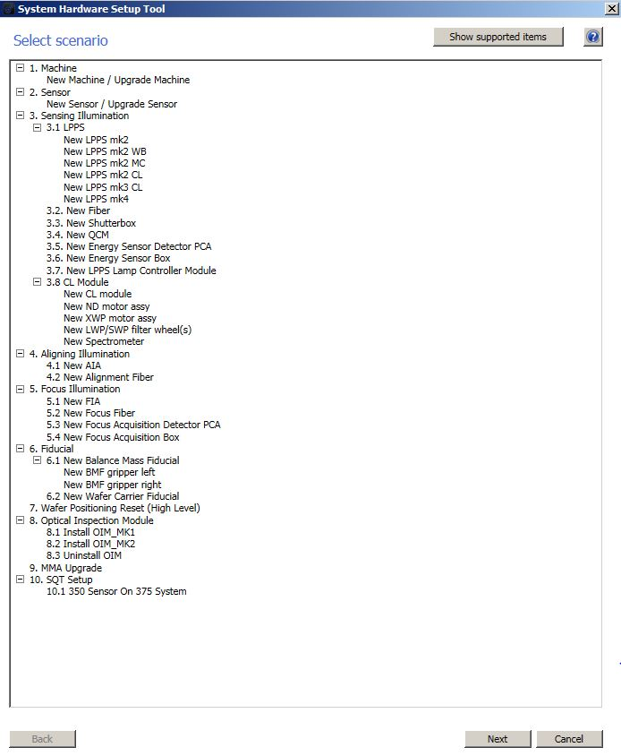
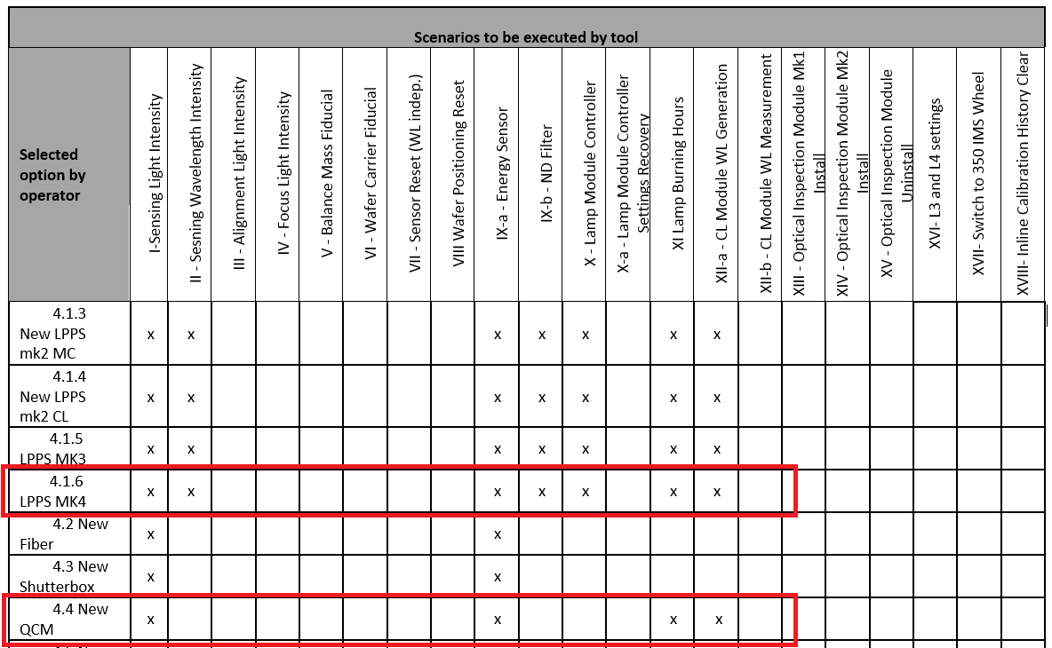
SHST support
Reset configuration constants and ECs depending on the selected scenarios.
Add 5 newly error/warning codes for SHST to support LPPS MK4 introduction.
Support FW update on LPPS Mk4

Slide 16
V model
Customer Business Processes
SPS, SDS, TPS
Customer Level
Alpha & Beta Test
Quality Gates
Business Specification
EPS, EDS, TPS
Functional Level
Acceptation Test
Inter FC
Specify
System Test
Qualify
Functional Specification
Technical Level
BB + FC Integration Test
EPS, EDS, TPS
Module Integration Test
STI team :
Merge code change
Alpha & Beta Test
SW Team :
SW EPDS, SW code change and SW TAR
Unit Test
Physics :
Provide A4 spec, verify dev patch
SW Code

Slide 17
Q & A

Slide 18
Backup Slides

Slide 19
CL Module
CL Calibrations
Task Name | Task Number | Q-Tool
Calibrate Illumination Spectrometer Wavelength Coarse | 600 | 613
Calibrate Illumination Wavelength Home Offset | 605 | 605
Calibrate Illumination Spectrometer DC Offset | 604 | 616
Check Illumination Spectrometer DC Offset | 623 | 624
Calibrate Illumination Spectrometer Non-Linearity | 611 | 617
Calibrate Illumination Spectrometer Irradiations | 612 | 618
Calibrate Illumination Spectrometer Wavelength Fine | 619 | 620
Check Illumination Spectrometer Wavelength Fine | 626 | 627
Calibrate Illumination Encoder Position to Wavelength | 602 | 602
Check Illumination Encoder Position To Wavelength | 625 | 625
Calibrate Illumination ND Filter Position | 601 | 601
Calibrate Illumination Wavelength Offset | 603 | 603
Check Illumination CLM Spectral | 630 | 630
Check Illumination Spectrometer | 628 | 629
Integration Time Determination Coarse | 609 | 609
Integration Time Determination Fine
Notes:
CL module parts are very sensitive. They are not preadjusted and stay at the same position for long. They continuously change position, the filters and light.
To adjust them with a set of calibrations is needed for better accuracy and at the end better performance of the YS system.

Slide 20
Back up slides
LampModuleControllerTool – details
CLM Tasks
Autofac
LPPS PowerOnSequence
Caliburn
Contract Example
Sensor Assembly
DP : Simple factory

Slide 21
Light Source Control Software

Slide 22
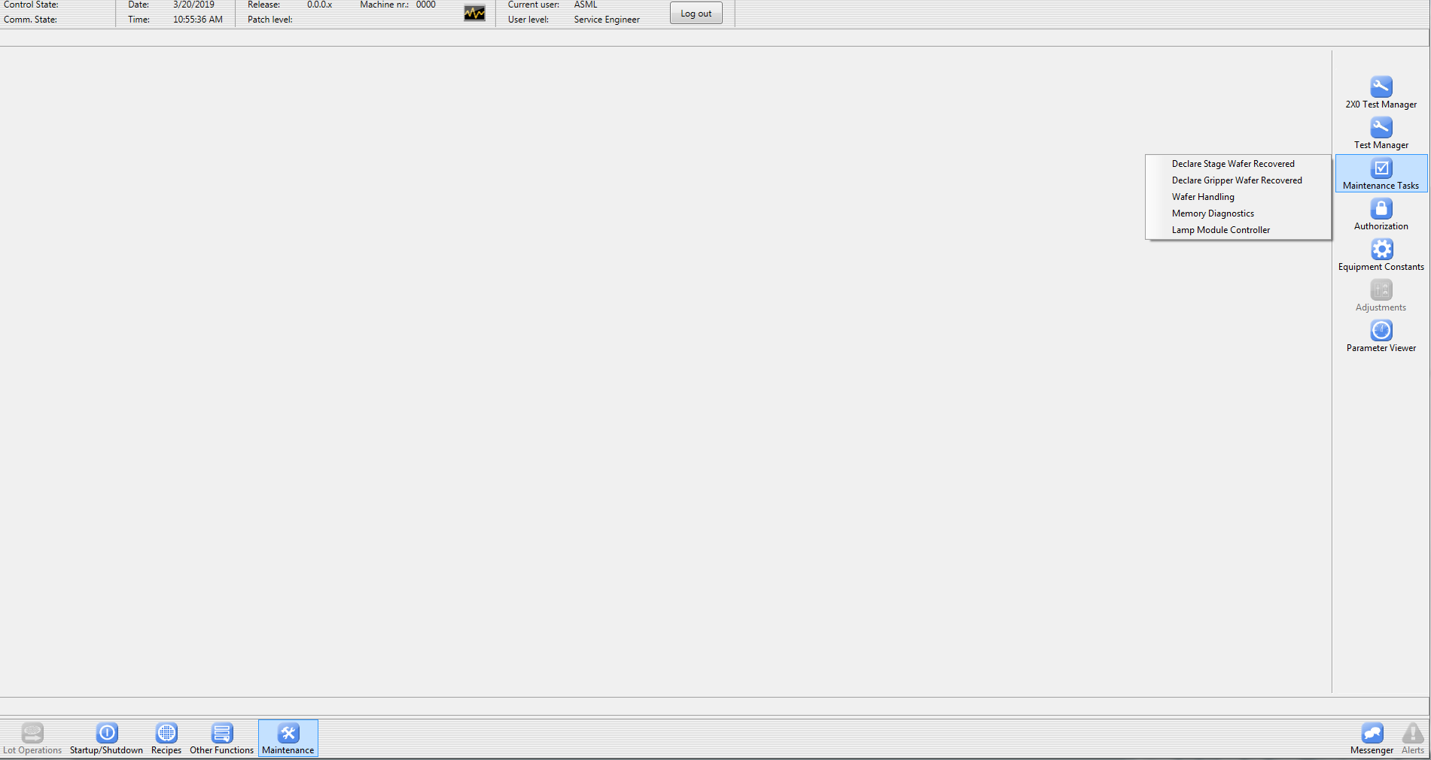

Slide 23
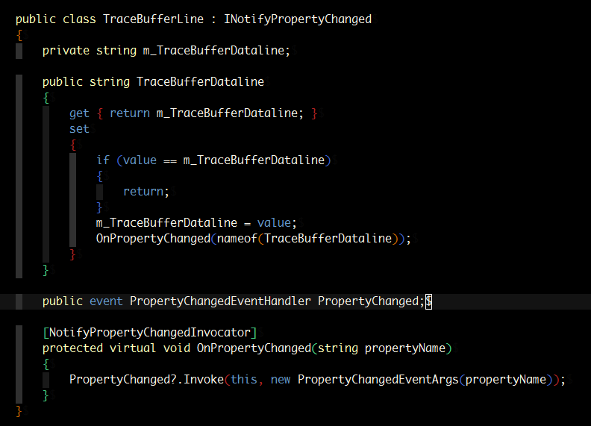
Caliburn.Micro;

Slide 24
CLM Tasks
ACE contributes 16 out of 24 blocks for CLM SP18 delivery!
Internal Spectrometer
CL Module
External Spectrometer
Task 623
DC Offset
Task 604
DC offset
Task 600
WL coarse
Task 605
WL home offset
Task 613
WL coarse
Task 616
DC offset
Task 624
DC offset
Task 611
Non-linearity
Task 612
Irradiance
Task 602
Enc Pos to WL
Task 625
Enc Pos to WL
Task 617
Non-linearity
Task 618
Irradiance
Task 626
WL fine
Task 619
WL fine
Task 601
ND filter
Task 641
ND filter
Task 620
WL fine
Task 627
WL fine
Task 628
Spectrometer
Task 610
Spectral
Task 629
Spectrometer
Task 603
WL offset
Task 630 has 603 included
existing task
< SP18
New task VHV
new task
ACE
Task 630
CLM spectral
Fig. Full YS(1)375 CL Module Tasks Package
Notes:
CLM source project contains 3 parts: internal/CLM/external….
Blocks with empty rectangle are existing tasks.
Others are newly introduced tasks.
Among them ACE participates……….
6 tasks for internal spectrometer/ 5 tasks for CL module/ 5 tasks for external spectrometer
Therefore, ACE contributes totally 16 tasks for CLM SP 18 delivery.

Slide 25
Working our way through the V-diagram
SPECIFY from SYSTEM to PART QUALIFY from PART to SYSTEM
Roadmapping
Qualify design versus requirements at all levels
PRS
TAR
(Beta test)
SPS
SDS
TAR
(Alpha test)
System
Sub
system
EPS TPS
EDS
TAR
Integrate
in proto
Module
(e.g., A4 spec.
Functional TPS)
EPS TPS
EDS
TAR
Integrate
in subsys
(e.g., Functional TAR)
SEG DOCUMENTS
PRS = Product Requirements Spec
SPS = System Performance Spec
SDS = System Design Spec
EPS = Element Performance Spec
EDS = Element Design Spec
TPS = Test performance Spec
TAR = Test Acceptance Report
TPD
TPD = Techn. Product Documentation
TPD
TAR
Parts
Integrate
module
(e.g., SW EDS, SW TPS)
(e.g., SW TAR)
Parts
SW Code
Notes:
Diagram explanation: - it is just a model - good points: - what you specify you need to verify/test later - you have decomposition according product breakdown top-down - integration follows product breakdown bottom-up - weak points: - there are many iterations, and things run concurrent during decomposition You use it as far as it can help you
EDS = design specification. Specification = formal definition. Your design = their requirement, requirement for lower level of product breakdown.
EPS = WHAT, EDS = HOW. If you need to delegate specify the what, and try to keep away from the how. It pulls on the creativity / expertise of the other. Example: schilderswinkel, if you want advice you can ask “I have to paint a wall and what do I need to get this done ?
The valley of the V -> after some ‘tours of duty’ you can oversee the complete development V at the start. Not only comfortably rolling down, but you have to climb up. So: can I get this manufactured, tested, integrated into module, into proto, operated at customer is part of the total development
added wk 1339, session 25

Slide 26
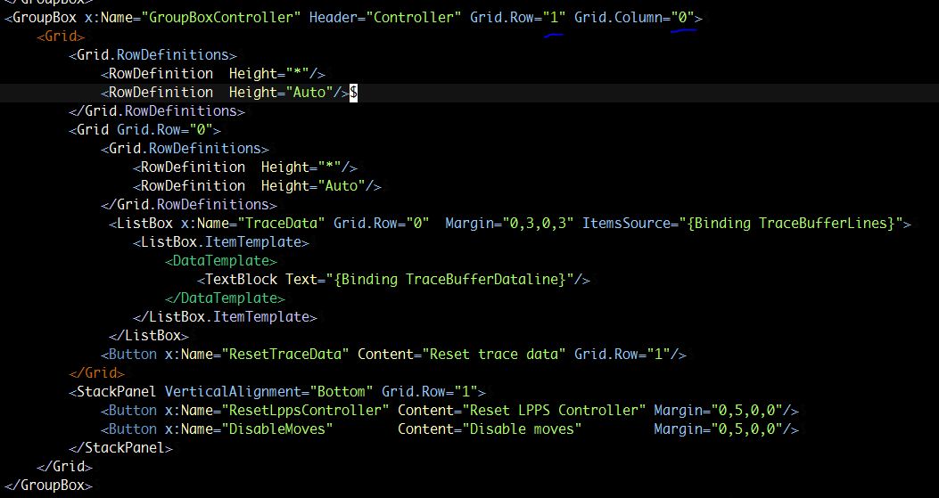
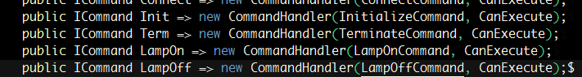
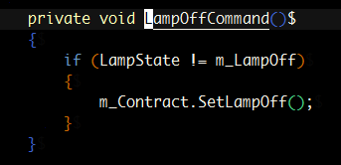
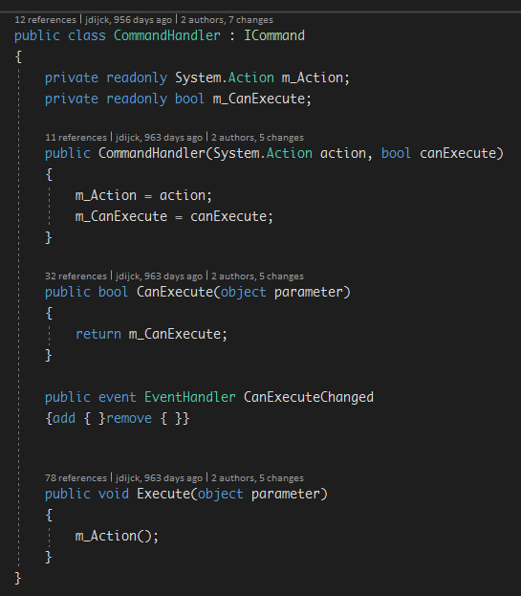
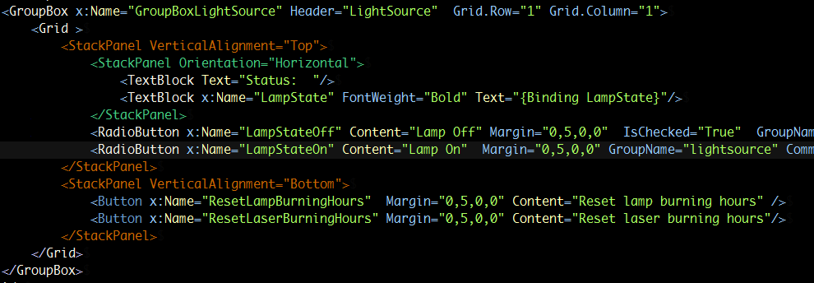
LampModuleControllerTool - details

Slide 27
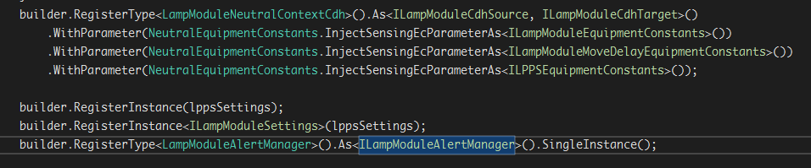
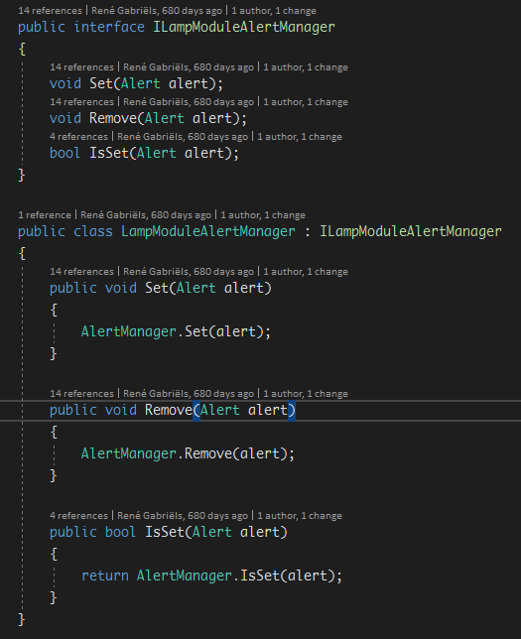
Autofac

Slide 28
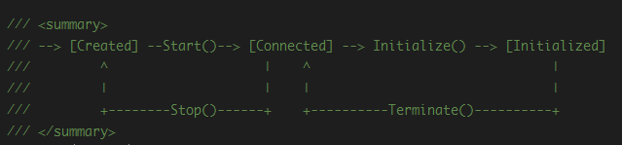
LPPS power on sequence

Slide 29
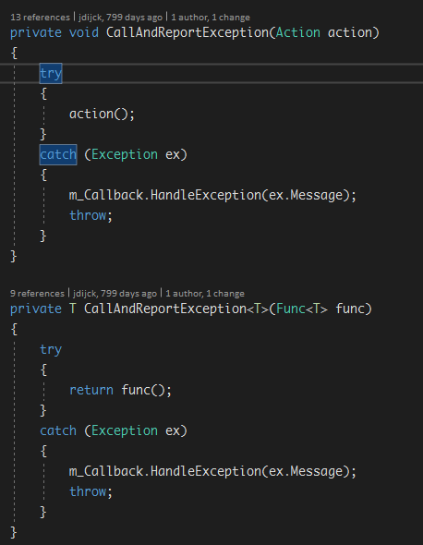
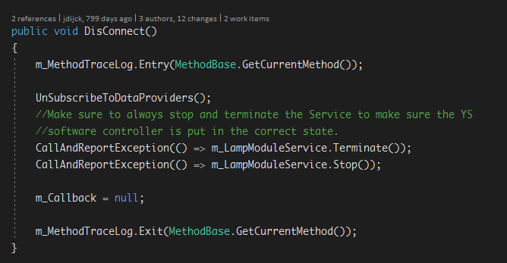
Lambda function as action

Slide 30
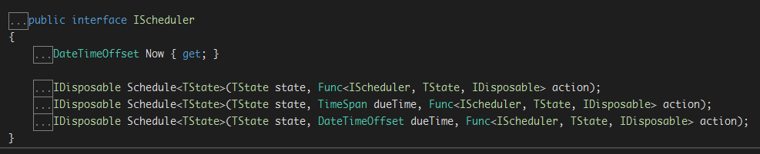
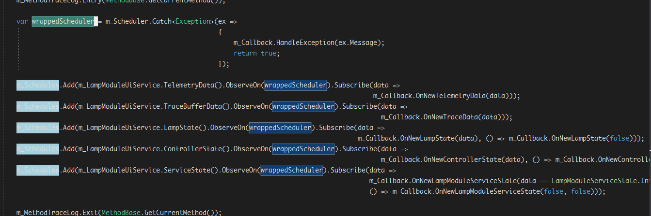
- IScheduler(hard)

Slide 31
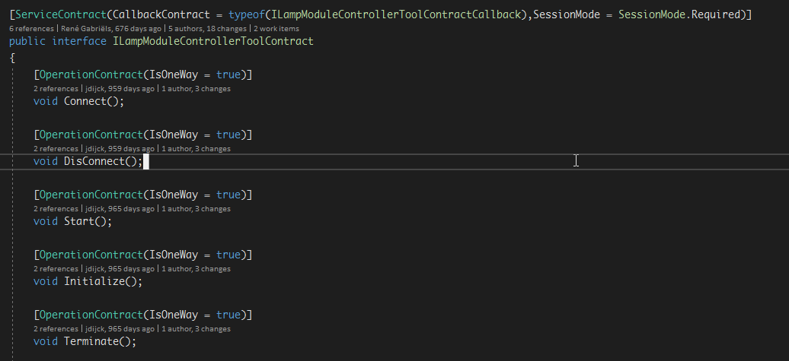
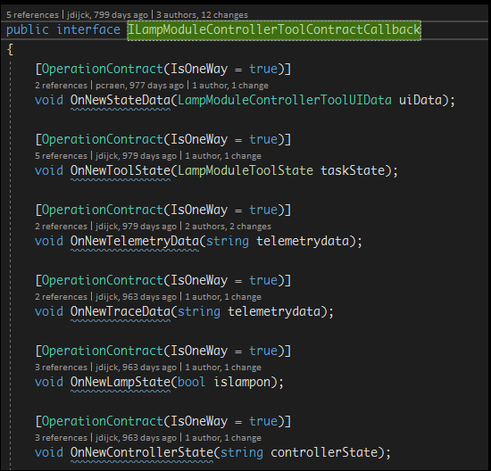
ILampModuleControllerToolContract
Used by ViewModel to control the back-end
Back-end need to implement those function
ILampModuleControllerToolContract
Implemented by LampModuleWcfService
In LampModuleWcfService, it got a front-end member(ContractCallback)
Below functions implemented by VM

Slide 32
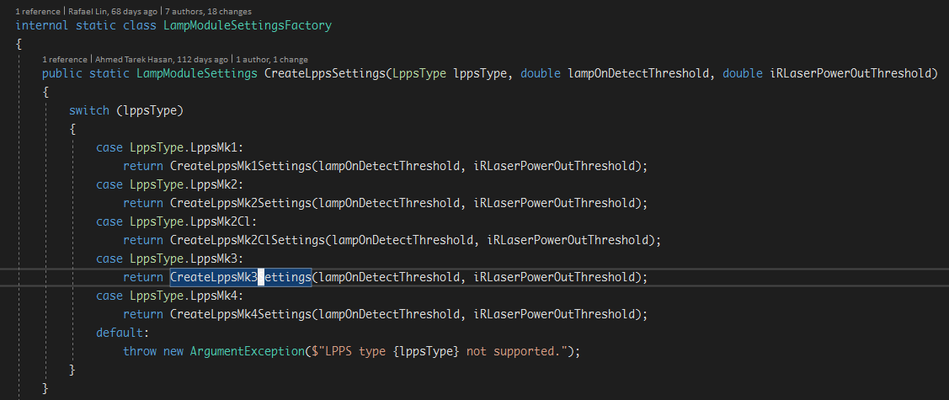
Simple Factory

Slide 33
YieldStar Sensor Sub-Assemblies
UIA
FBDA
FBIA

Slide 34
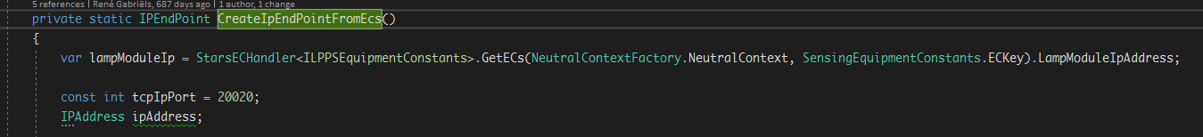
Get data from EC in a quick mode

Slide 35
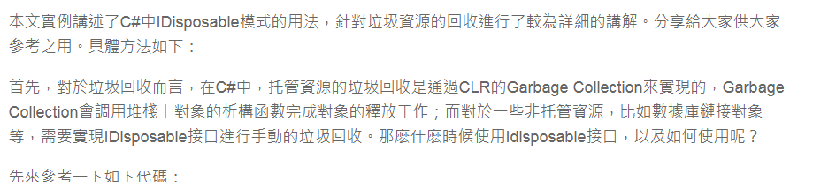
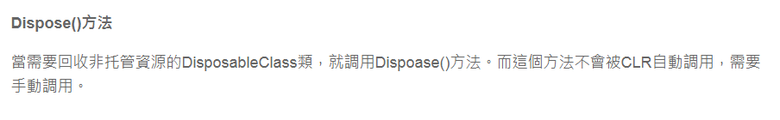
Disposable
link

Slide 36
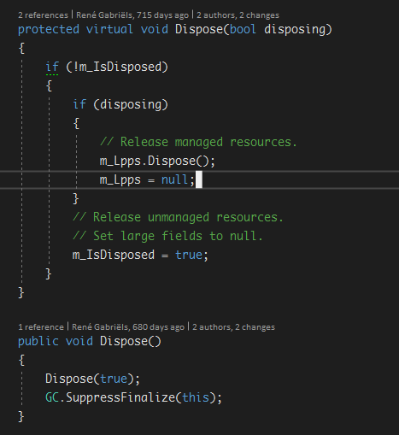
Idispose sample code for LampModule
Lamp.cs

